Slide 1
Categorical Data Analysis
Lecturer: Zhenghui FENG
zhfengwise@xmu.edu.cn

Slide 2


Zhenghui Feng(冯峥晖)
Associate Professor
Research Interests
Applied Statistics, Functional Data Analysis,
Dimension Reduction, Variable Selection
Education
PHD Statistics, Department of Mathematics,
Hong Kong Baptist University
MSc Statistics, School of Mathematics,
Beijing Normal University, China
zhfengwise@xum.edu.cn
Economic Building D207
Webpage

Slide 3
Contact Me
Office Hour: Monday 9:00-11:00 am
Office: D207 Economic Building
Email: zhfengwise@xmu.edu.cn

Slide 4
Useful Links
Zhenghui Feng
l.xmu.edu.cn
http://l.xmu.edu.cn/→ http://l.xmu.edu.cn/→经济学院 School of Economics →2020-2021→ Categorical Data Analysis (属性数据分析) 2020-2021 Fall
The R Project for Statistical Computing

Slide 5
Syllabus
Course Description
Categorical data, inference for contingency tables, generalized linear models, with emphasis on logistic regression and logit models
Does not require familiarity with advanced mathematics such as calculus or matrix algebra
Prerequisties
Probability and Statistics
Linear Model
Estimation
Testing Theory

Slide 6
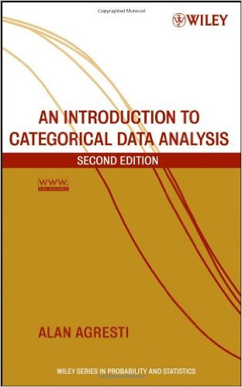
Syllabus
Required Textbooks
An Introduction to Categorical Data Analysis.
Second Edition. Alan Agresti (2007). John Wiley & Sons.
Optional Textbooks:
Analysis of Categorical Data. Agresti, A., New York: Wiley, 2002.
Generalized Linear Models. 2nd Ed. McCullagh P. and Nelder J., London: CRC Publishers, 1989.
《属性数据分析引论（第二版）》张淑梅 王睿 曾莉 译， 高等教育出版社.
《实用多元统计方法与SAS系统》高惠璇，北京大学出版社.

Slide 7
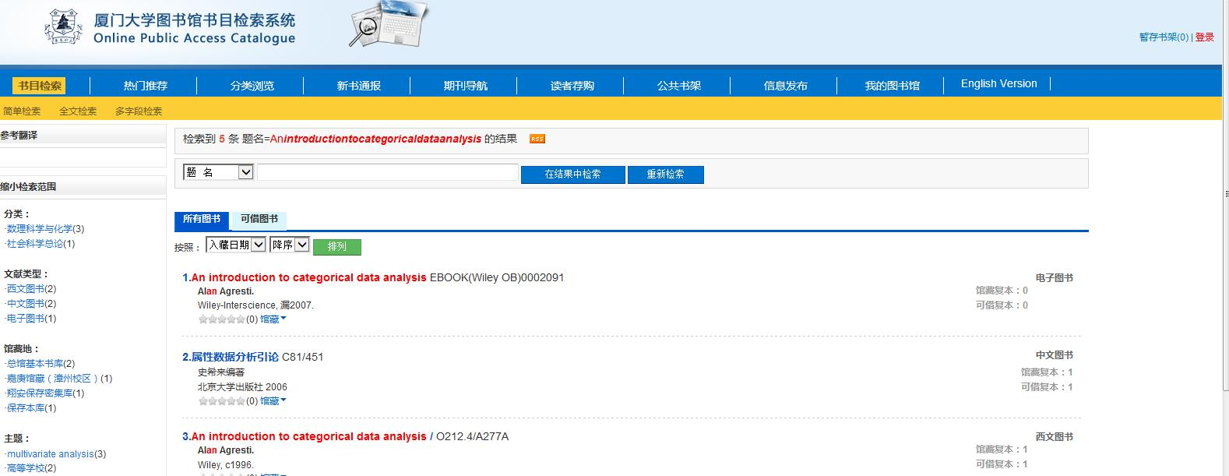
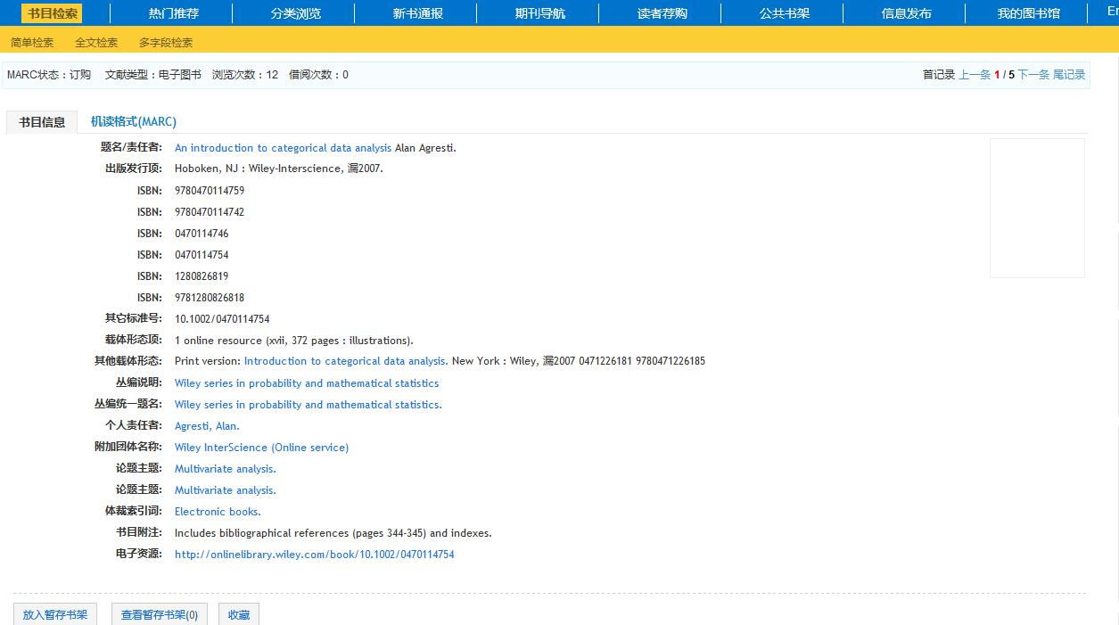

Slide 8
Syllabus
Grade Policy
Attendance and Practice | 10%
Homework | 10%
Midterm Exam | 25%
Project | 30%
Final Exam | 25%

Slide 9
Syllabus
TA:
Course QQ group

Slide 10
Syllabus
Course Outline
Preface
Chapter 1. Introduction
Chapter 2. Contingency Tables
Chapter 3. Generalized Linear Models
Chapter 4. Logistic Regression
Chapter 5. Building and Applying Logistic Regression Models
Chapter 6. Multicategory Logit Models

Slide 11
Chapter 1 Introduction

Slide 12
Categorical Data Analysis (CDA)
What is categorical data (analysis)？
Why categorical data analysis？
How to do categorical data analysis？

Slide 13
Example
A survey is conducted among 50 people, asking them: “Which one of the following is your favorite, Orange juice(O), Apple juice(A), Coca Cola(C), Pepsi(P) or Lulu(L, Almond drink) ? ”
Data collected are
O, A, C, A, C, P, C, A, C, C, C, A, L, O, C, P, A, O, L, P, L, O, C, L, P, O, O, C, A, L, C, L, L, C, C, L, C, L, P, O, C, A, P, A, C, C, L, L, C, P
Question: Which one is the most popular?

Slide 14
Table: Frequency and percentage of favorite drink
Drink | Frequency | Percentage
Orange Juice | 7 | 14
Apple Juice | 8 | 16
Coca Cola | 17 | 34
Pepsi | 7 | 14
Lulu | 11 | 22
Total | 50 | 100

Slide 17
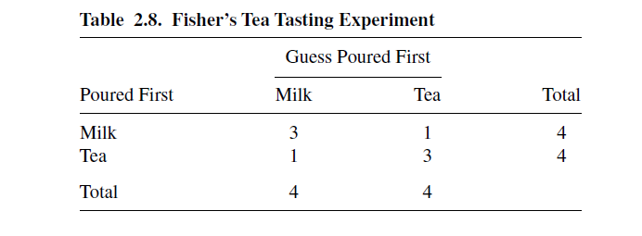
Example: Fisher’s Tea Taster
When drinking tea, a colleague of Fisher’s at Rothamsted Experiment Station near London claimed she could distinguish whether milk or tea was added to the cup first. To test her claim, Fisher designed an experiment in which she tasted eight cups of tea.
Four cups had milk added first, and the other four had tea added first. She was told there were four cups of each type and she should try to select the four that had milk added first. The cups were presented to her in random order.

Slide 18


Example: Aspirin and Heart Attacks
?

Slide 19
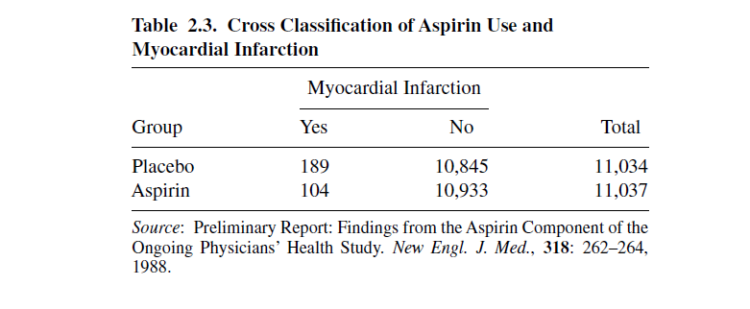
Example: Aspirin and Heart Attacks
Table 2.3 is from a report on the relationship between aspirin use and myocardial infarction (heart attacks) by the Physicians’ Health Study Research Group at Harvard Medical School
The Physicians’ Health Study was a five-year randomized study testing whether regular intake of aspirin reduces mortality from cardiovascular disease
Every other day, the male physicians participating in the study took either one aspirin tablet or a placebo. The study was “blind”- the physicians in the study did not know which type of pill they were taking

Slide 20
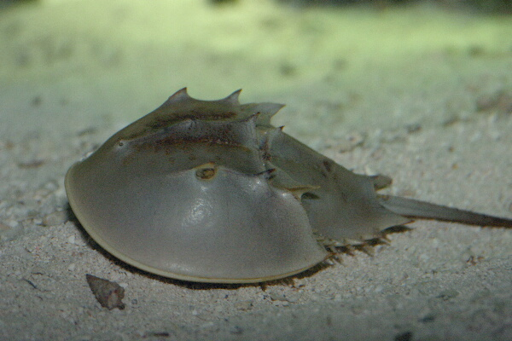
Example: Female Horseshoe Crabs and their Satellites
A study of nesting horseshoe crabs (J. Brockmann, Ethology,102: 1–21, 1996). Each female horseshoe crab in the study had a male crab attached to her in her nest.
The study investigated factors that affect whether the female crab had any other males, called satellites, residing nearby her. The response outcome for each female crab is her number of satellites.

Slide 21

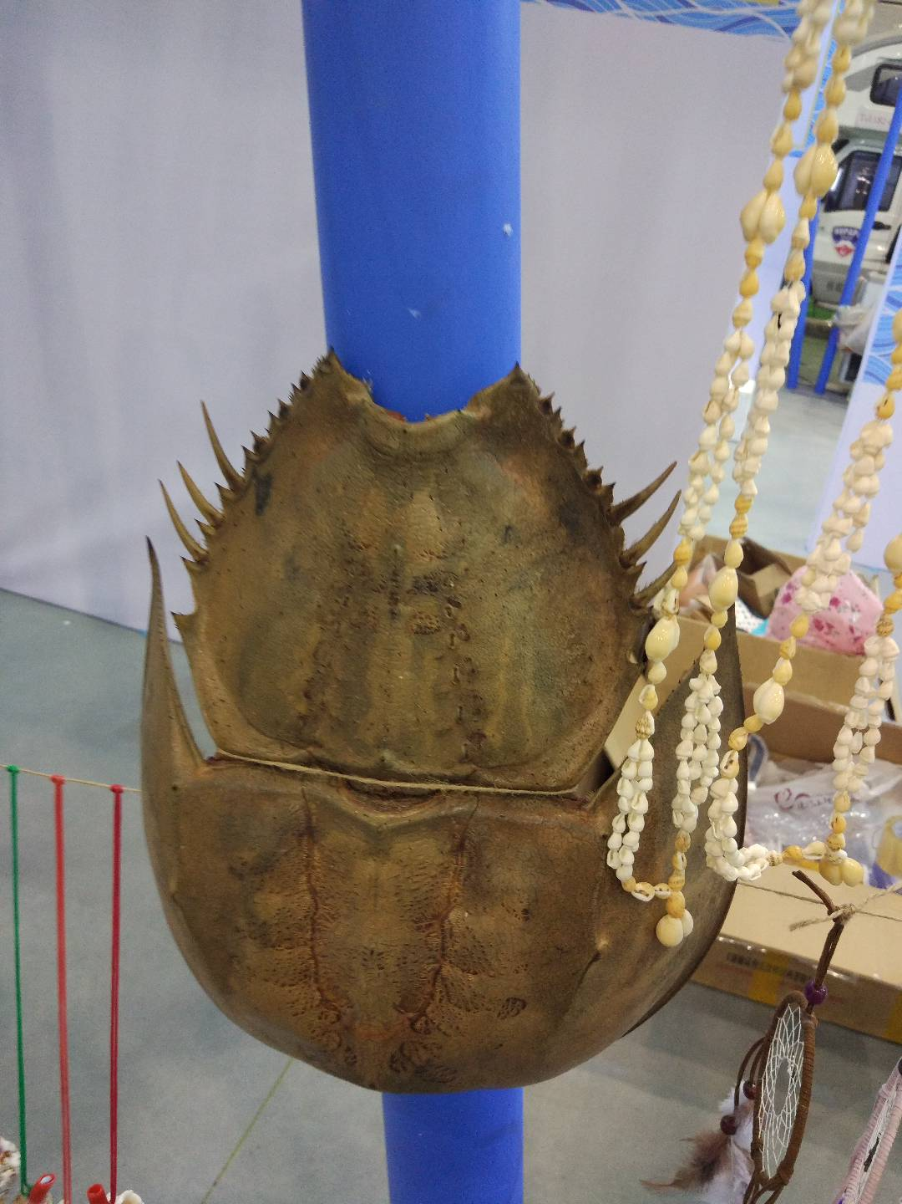



Slide 22
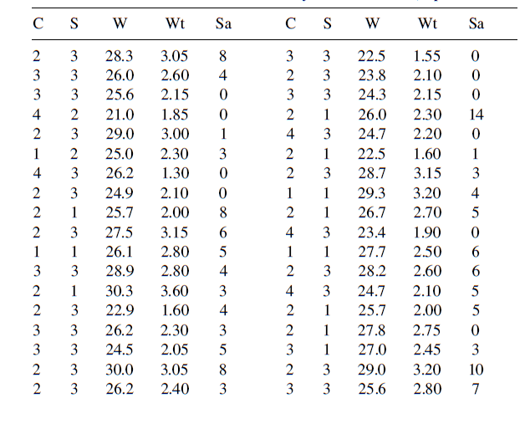
C: color S: spine condition W: width Wt: weight Sa: number of satellites

Slide 23
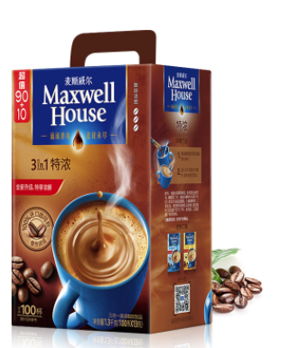
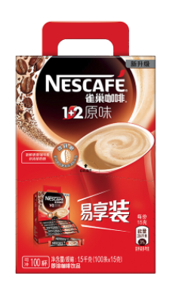
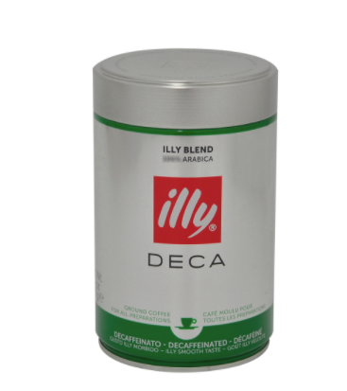
Example: Coffee brand market share
A survey recorded the brand choice for a sample of buyers of instant coffee. At a later coffee purchase by these subjects, the brand choice was again recorded. Table 8.5 shows results for five brands of decaffinated coffee.
Question: Is there evidence that most buyers change their brand choice?

Slide 24
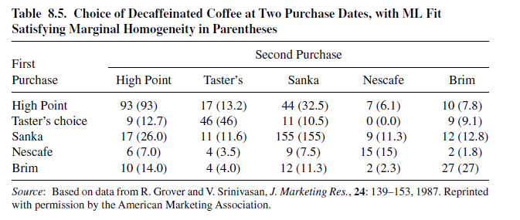

Slide 25


Example: Analyzing rater agreement
Quesiont: How to analyze matched-pairs data, referring to separate ratings of a sample by two observers using the same categorical scale? Each matched pair consists of the ratings by the two observers for a particular slide.

Slide 26
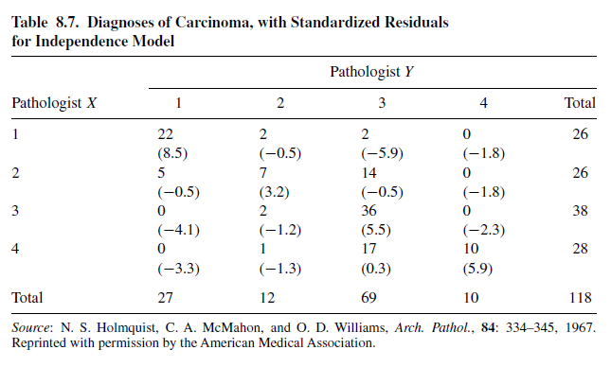
Table 8.7 shows ratings by two pathologists, labeled X and Y , who separately classified 118 slides on the presence and extent of carcinoma of the uterine cervix. The rating scale has the ordered categories (1) negative, (2) atypical squamous hyperplasia, (3) carcinoma in situ and (4) squamous or invasive carcinoma.

Slide 27
Categorical Data Analysis (CDA)
What is categorical data (analysis)？
Why categorical data analysis？
How to do categorical data analysis？

Slide 28
Categorical Data
Continuous
Quantitative
Discrete
Variable
Ordinal
Categorical
Qualitative
Nominal

Slide 29



Categorical data
Nominal
Ordinal
Discrete

Slide 30
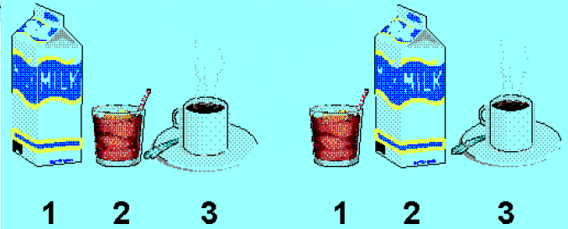
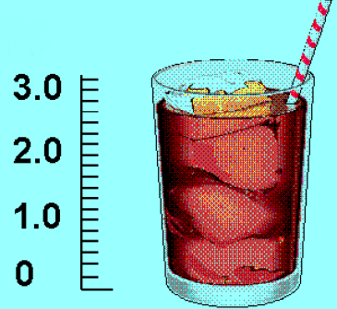
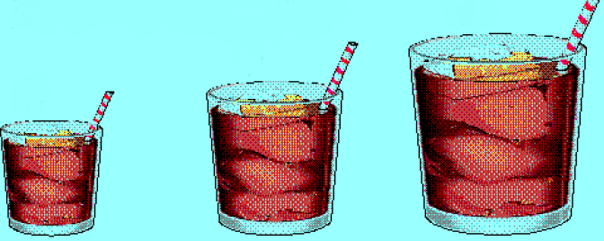
Nominal
Continuous
Ordinal

Slide 31
Why do we need CDA?
Applications
Applications in biomedical and social sciences, etc.
Methodology
It is unnecessary and often inappropriate to use methods for continuous data with categorical response

Slide 32
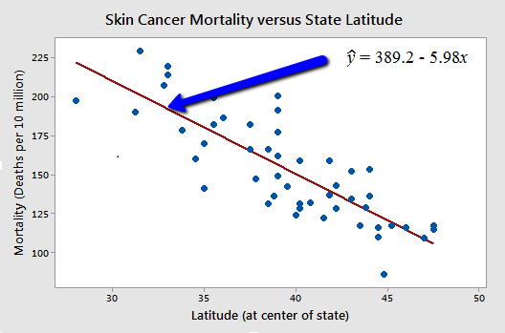
Why?
Why not linear regression model？

Slide 33
Any other methods?
For binary response (Y=0,1)
Generalized linear model

Slide 34
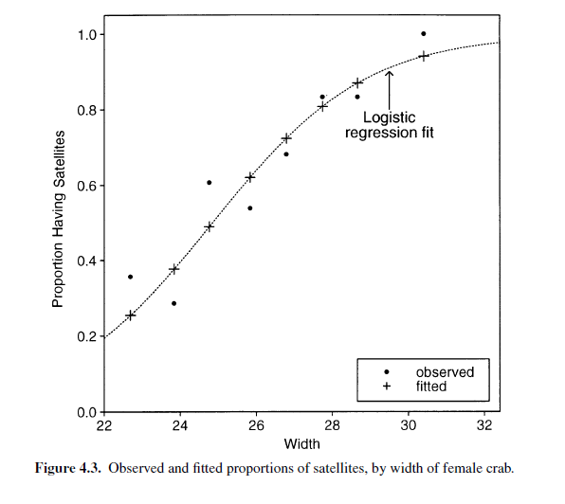
Logistic regression
Logistic Regression Model

Slide 35
Generalized linear model(GLM)
Loglinear Model
Linear Probility Model

Slide 36



Slide 37


A Study of Product Placement in Celebrities’ Blogs
——Based on the Xiaohongshu™ App
Salary Analysis and Prediction for the Positions in the
Financial Industry

Slide 38
How to Describe Categorical Data
Tables
Frequency Table, Percentage Table, …
Charts
Bar chart, Pie chart, Histogram, Stem leaf, …
Statistics
Average, mode, median, percentile, …

Slide 39
Methods
Contingency Tables
Generalized Linear Models
Multi-category Logit Models
Logistic Regression

Slide 40
Reading List
Darrell Huff (1991) How to Lie with Statistics New Ed edition, ISBN 0-14-013629-0
Rao C R. (1997) Statistics and truth: putting chance to work World Scientific.
Salsburg, D. (2002) The Lady Tasting Tea: How Statistics Revolutionized Science in the Twentieth Century, W.H. Freeman / Owl Book. ISBN 0-8050-7134-2
Reinhart A. (2015) Statistics done wrong: The woefully complete guide No Starch Press.
Moore S. and Notz W. (2017) Statistics: Concepts and Controversies 9th Edition.

Slide 41
History of CDA
1900
1900-1912
1951
Pearson
Chi-square
Contingency
Yule
Odds ratio
Simpson
Simpson’s paradox
R.A. Fisher
DF of I X J table
Fisher Exact Test
Logistic Model
Contingency Table
Fisher and Frank Yates
Joseph Berkson
McCullagh …
William Cochran
Nathan Mantel
Leo Goodman …

Slide 42
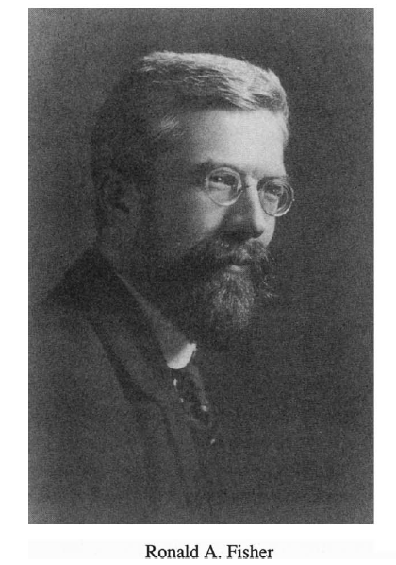
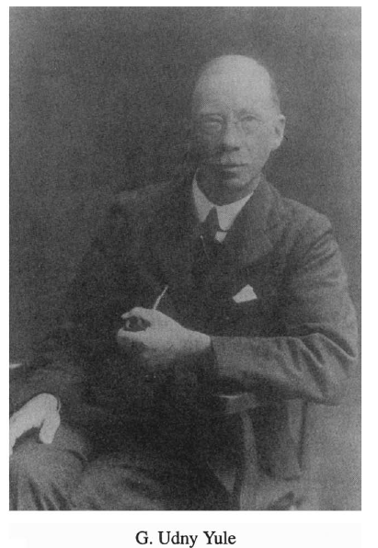
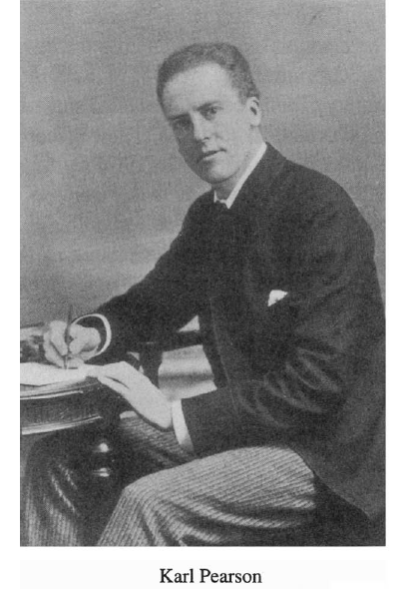
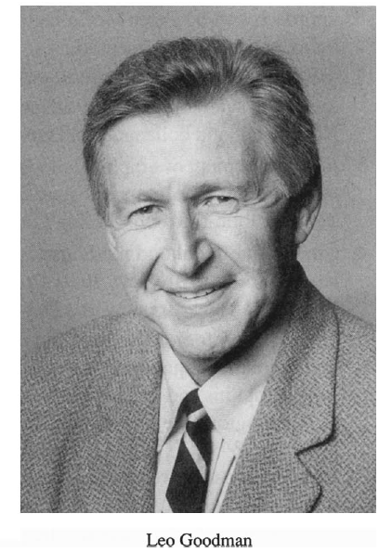
History of CDA

Slide 43
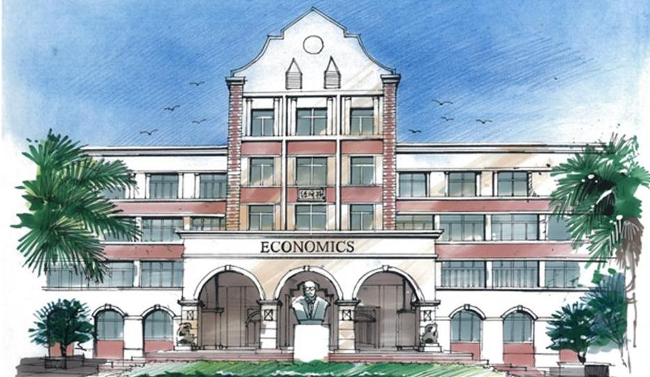
Homework 1
1. Read Preface, Chapter 11 and Chapter 1 carefully
2. Problems in textbook 1.2, 1.4, 1.5, 1.6, 1.12.

